Slide 1

of Effective Communication

Slide 2

EFFECTIVE COMMUNICATION
Effective communication is one in which,
A message is conveyed clearly and without ambiguity ,and
A message is understood as intended by the producer

Slide 3
PRINCIPLES OF EFFECTIVE COMMUNICTAION
There are SEVEN important principles of effective communication.
They must be followed if one wants to be a successful and competent communicator.
7 Cs must be observed in both ORAL and WRITTEN communication.

Slide 4
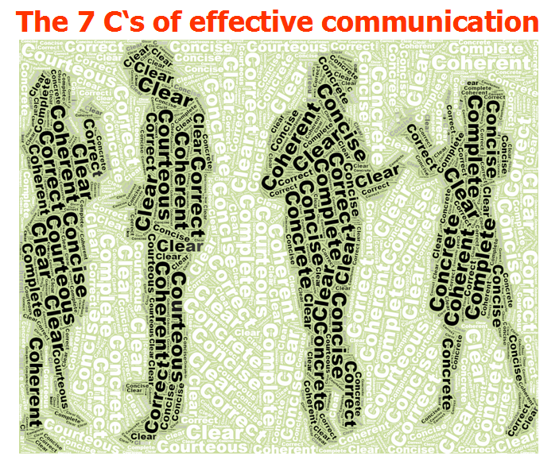
THE SEVEN C’s ARE
Completeness
Conciseness
Consideration
Concreteness
Clarity
Courtesy
Correctness

Slide 5
The order we will follow:
Completeness
Concreteness
Considerate
Conciseness
Courtesy
Correctness
Clarity

Slide 6
COMPLETENESS
A message is complete when it contains all the facts that a reader or listener needs for the reaction you desire.
As you strive for completeness, keep the following guidelines in mind:
Provide all necessary information.
Answer all questions asked.
Give some extra information when desirable.

Slide 7
Provide All Necessary Information
Answering the five W’s helps make messages clear:
Who, What, When, Where, and Why.
Answer All Questions Asked
Look for questions. Some may even appear buried within a paragraph. Locate them and then answer precisely.
Give Some Extra Information , When Desirable
Use your good judgment in offering additional material if the sender’s message was incomplete.

Slide 8
Example of Completeness (In email)
“Dear Sir/Ma'am,
My name is Javeria Ali, and I am applying for the Ph.D program at XYZ University. While filling out the form, I am facing difficulty as I cannot choose in the section "desired discipline". This section is not giving me any options, and I am unable to submit my form without filling in the section. Can you please help me regarding this?
Attaching here the screenshot of the page.
Awaiting your response. ”

Slide 9
Completeness (Debacle) “Response to the email”
“Your Last Degree (Subject)
Regards, ”
(Incomplete response to the email. It does not address any concerns whatsoever)

Slide 10
Exercise
You are the president of an industry association and have received the following inquiry from an out of town member, “I think I would like to attend my first meeting of the association even though I am not acquainted with your city. Will you please tell me where the next meeting is being held?
How would you reply to this letter keeping in mind Completeness of the message?

Slide 11
Exercise
The following statement lacks completeness. Rewrite it providing the missing information.
“The new admit cards can be collected from the Admin Block.”

Slide 12
CONCRETENESS
Communicating concretely means being specific, definite, and vivid rather than vague and general. Often it means using denotative (direct, explicit, often dictionary based) rather than connotative words (ideas or notions suggested by or associated with a word or phrase).
The following guidelines should help you compose concrete, convincing messages:
Use specific facts and figures
Put action in your verbs
Choose vivid, image building words

Slide 13
Use Specific Facts and Figures
It is desirable to be precise and concrete in both written and oral communication.
Vague, General, Indefinite
“Student GMAT scores are higher.”
Concrete, Precise
“In 1996, the GMAT scores averaged 600; by 1997 they had risen to 610.”

Slide 14
Rewrite the following in concrete form as the sentences are too general and vague.
Exercise
This computer reproduces campaign letters fast
Our product has won several prizes.
These brakes stop a car within a short distance.

Slide 15
Put Action in Your Verbs
Use active rather than passive verbs.
Put action in your verbs rather than nouns and infinitives.

Slide 16
Put action into the words by using active instead of passive voice.
Exercise
Tests were made by us..
A full report will be sent to you by the supervisor.
The contract had a requirement…

Slide 17
Choose Vivid, Image-Building Words
Business and scientific writing uses less figurative language than does the world of fiction.
Bland Image
This is a long letter.
More Vivid Images
This letter is three times as long as you said it would.

Slide 18
Use vivid image building words – adjectives and adverbs , and use less of abstract nouns
Exercise
The camera has a system that gives good pictures.

Slide 19
CONSIDERATION
Consideration means preparing every message with the message receivers in mind; try to put yourself in their place. You are considerate, you do not lose your temper, you do not accuse and you do not charge them without facts. The thoughtful consideration is also called “you-attitude”.
Focus on “You” instead of “I” and “We”.
Show audience benefit or interest in the receiver.
Emphasize positive, pleasant facts.

Slide 20
Focus on “You” Instead of “I” or “We”
Using “you” does help project a you-attitude. But overuse can lead to a negative reaction.
Example
We-Attitude: I am delighted to announce that we will be extending our hours to make shopping more convenient.
You-Attitude: You will be able to shop evenings with the extended hours.

Slide 21
Show Audience Benefit or Interest in the Receiver
Reader may react positively when benefits are shown to them.
Benefits must meet recipients’ needs, address their concerns, or offer them rewards.

Slide 22
Exercise
Write with a ‘you ‘ attitude that it shows consideration
I want to send my congratulations for ----
We will ship soon the goods for your May 4 order----
We pay eight percent interest on -----

Slide 23
Write with a ‘you’ attitude , that it shows consideration ( contd.)
Exercise
May I take this opportunity to express my thanks for the account you recently opened with our store. We are pleased to furnish a wide variety of products for the home of the individual customer. We want you to take full advantage of the store services, for we have the largest store in the city. Also we make deliveries for our customer free of charge with in a 30 miles radius of our store. We welcome you to Creativity. If we can be of additional help please let us know .

Slide 24
Avoid negative – unpleasant words to show consideration
Exercise
It is impossible to open an account for you today.
We don’t refund if the returned item is soiled and unusable.
When you travel on company expense, you will not receive approval for first class fare.

Slide 25
Show reader benefit or interest in the letter from an insurance company to policy holders .
Exercise
Because we have not written to you in sometime , please help us bring our record by filling and returning the other half of the card .

Slide 26
CONCISENESS
Conciseness is saying what you want to say in the fewest possible words without sacrificing the other C qualities. A concise message is complete without being wordy.
To achieve conciseness, observe the following suggestions;
Eliminate wordy expressions.
Include only relevant material.
Avoid unnecessary repetition.

Slide 27
Eliminate Wordy Expressions
Use single words in place of phrases.
Example
Wordy: At this time
Concise: Now
Wordy: Due to the fact that
Concise: Because

Slide 28
Include Only Relevant Material
Example
Wordy:
We hereby wish to let you know that our company is pleased with the confidence you have responded in us.
Concise:
We appreciate your confidence.

Slide 29
Exercise Find single word substitutes for the following phrases.
Along the same lines
At this time
Consensus of opinion
Due to the fact that
During the time of the day
During the year of
Few and far between
For a price of
Similarly
Now
Mutually
Because
While
During
Rare/scarce/ occasional
Cost/term/rate

Slide 30
Exercise
Make the following statements concise.
On account of the continuous and perpetual marches and rallies, the government has taken the decision to remove the clause that provides support to the public to express dissatisfaction and anger by protests.
The students were tired and exhausted and requested and urged to be given a break to refresh and relax.

Slide 31
COURTESY
True courtesy involves being aware not only of the perspective of others, but also their feelings. Courtesy stems from a sincere you-attitude.
The following are suggestions for generating a courteous tone;
Be sincerely tactful, thoughtful, and appreciative.
Use expressions that show respect.
Choose nondiscriminatory expressions.

Slide 32
Be Sincerely Tactful, Thoughtful, and Appreciative
Though few people are intentionally abrupt or blunt, these negative traits are a common cause of discourtesy.
Tactless, Blunt
More Tactful
Stupid letter; I can’t understand any of it.
Clearly, you did not read my latest fax.
It’s my understanding…
Sometimes my wording is not precise; let me try again

Slide 33
Bad Examples
Miss can you respond (Daunting and commanding tone)
Miss i did not do hand written work. I did typing and send you doc file is it ok can I do same in paper writing then taking pictures and converting it in pdf is a headache (Direct tone, informal)
Regardless of that I’ll be there to check paper for sure. (Direct, impolite tone)

Slide 34
Good Example
“Respected Ma'am, This is XYZ, your former Communication and TRW student. Hope you and your family are doing well in this Quarantine. I pray that things become easier for you and your entire family. This email is to request you politely to share the previous fyp report soft copy. Thank you in advance for your time. (Polite and friendly tone)
Yours Sincerely,
XYZ”
(Because it was unclear to the recipient, the sender sent a clarification email)
“Allow me to correct myself. I need a fyp report that you consider is the best sample for the new report. It could be a previous fyp report or any other student's trw report.” (Courteous, polite tone)

Slide 35
Use Expressions that Show Respect
No reader wants to receive message that offend.
Omit Irritating Expressions
You are delinquent
You failed to
Contrary to your Inference
Inexcusable
Simply nonsense

Slide 36
Choose Nondiscriminatory Expressions
Another requirement for courtesy is the use of nondiscriminatory language that reflects equal treatment of people regardless of gender, race, ethnic origin, and physical features.
Questionable
More Desirable
Freshman
Manpower
Entering students; first year student.
Workers; employees; work force personnel

Slide 37
Re-write the following sentences by implying courtesy and by avoiding tactless & blunt language.
Exercise
Your letter is not clear at all.
Obviously, if you would read your policy carefully you will be able to answer these questions yourself.
Apparently you already forgotten what I wrote you two weeks ago.

Slide 38
Use gender friendly substitutes
Exercise
Mankind
The best man for the job
Manmade
Manpower
Businessman
Salesman
Chairman

Slide 39
Exercise
You guys should all be concerned about the issue.
Each manger has an assigned place – he should park his car….
Each customer will have change noted on his bill

Slide 40
CORRECTNESS
At the core of correctness is proper grammar, punctuation, and spelling.
However a message may be perfect grammatically and mechanically, but still insult or lose a customer. Correctness, means the following three characteristics:
Use the right level of language.
Check accuracy of figures, facts, and words.
Maintain acceptable writing mechanics.

Slide 41
Use the Right Level of Language
Informal writing is more characteristics of business writing—even more so if that writing occurs in an E-mail message.
More Formal
Less Formal
Participate
Procure
Endeavor
Join
Get
Try
Check Accuracy of Figures, Facts, and Words
A good check of data is to have another person read and comment on the validity of the material.

Slide 42
Faulty language
Asslam-0-alikum miss! How are you? I am your student from last semester(6th). i made my CV for job can you please review it at once (Asking “how are you”, basic grammatical errors, wrong use of preposition “at” that makes it impolite)
Miss i uploaded my file but it is not showing all pages to me some pages are not downloading can you please see and conform (Spelling, punctuation and grammatical errors)

Slide 43
CLARITY
Getting the meaning from your head to the head of your reader accurately is the purpose of clarity. We all carry around our own unique interpretations, ideas, experiences associated with words, so the barriers may be a hurdle.
Choose precise, concrete and familiar words.
Construct effective sentences and paragraphs.

Slide 44
Choose Precise, Concrete, and Familiar Words
Clarity is achieved in part through a balance between precise language and familiar language. Precise words need not be pretentious.
Familiar
Pretentious
About
After
Home
For example
Circa
Subsequent
Domicile
e.g.

Slide 45
Construct Effective Sentences and Paragraphs
Important characteristics to consider are length, unity, coherence, and emphasis.
Unclear: Being an excellent lawyer, I am sure you can help us.
Clear: Being an excellent lawyer, you can surely help us.

Slide 46
Exercise Use simple words. Use can use dictionary for meanings
Idiosyncratic
Enormity
Callous
Subsequent
Promulgate
Inadvertence
Domicile
Remuneration
Particular
Irregularity
Indifferent
Next
Known/ Public
Unintentional
Residence
Payment

Slide 47
Re-write the following sentences by choosing a conversational style.
Exercise
After perusal of pertinent data the conclusion is that a lucrative market exists for the subject property .
Easement for egress and ingress
A letter from the quality bureau to a plumber said – “The efficacy of hydrochloric acid is indisputable, but the corrosive residue is incompatible with metallic permanence “.

